Slide 1
SESSION-2 COMMUNICATION AND CV
-NITHIN

Slide 2

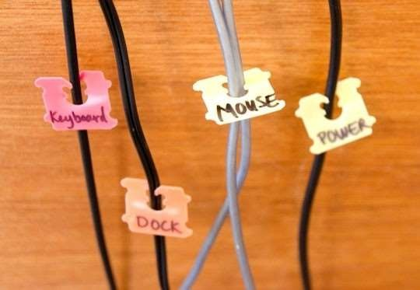
Need for WiFi
7
Cables for Keyboard, Mouse, Power etc.

Slide 3

Freedom from wires!!
8

Slide 4
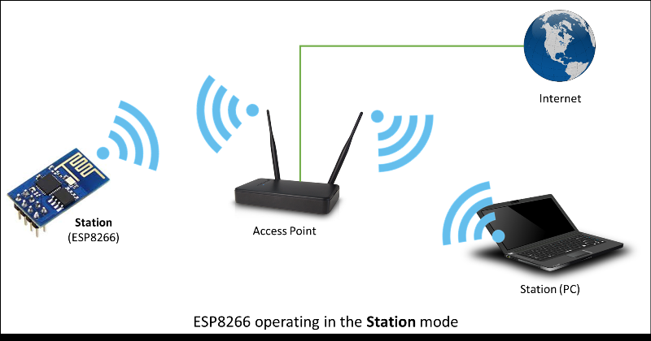
Different Wi-Fi Modes
Station Mode
A device in station mode connects to a Wi-Fi network hosted by another module or device.
Ex: Your laptop connected to Jio-Fi
Access Point Mode
A device operating in Access point mode hosts the Wi-Fi connection.
Ex: Your Jio-Fi
Notes:
Access point,station mode

Slide 5
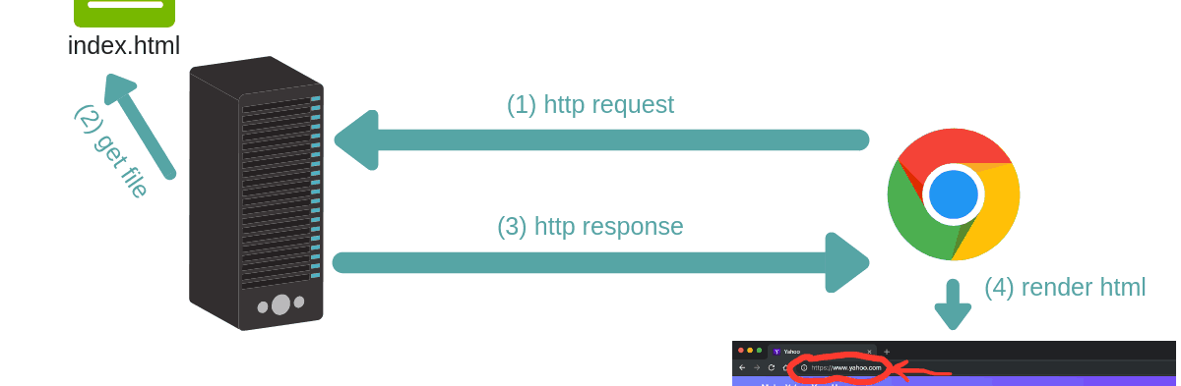
HTTP

Slide 6




Web Server
A web server is specialised software that responds to client (I.e. web browser) requests
Every web site requires a web server to process client requests and ‘serve up’ the pages
Web servers used to service Internet, intranets and extranets
Note that web server in this context is software. Server machine is also referred to as the web server.

Slide 7


Client-Server model and HTTP
HTTP IS THE DE FACTO STANDARD FOR TRANSFERRING WORLD WIDE WEB DOCUMENTS
USUALLY TO PORT 80
HTTP MESSAGES (REQUESTS AND RESPONSES) BETWEEN CLIENT AND SERVER ARE HUMAN READABLE

Slide 8

Client-Server model and HTTP
A request is generated by a client (by browser software)
Most common requests are “Get” and “Post”
Request reaches the appropriate web-server
Request is processed by the web-server
A response is formulated by the web server and sent back to the client (e.g. web page contents)

Slide 9
What is IP Address?
IP Address is Internet Protocol which is used to identified the HOST, NETWORK
IP Address is 32 Bit Logical Address
IP Address is divided in four octet which is separated by DOT (.)
An octet is a set of 8 bits .
Eg 192.168.43.52
Each device on a network will be assigned a unique IP address.

Slide 10
Libraries Used
ESP8266WiFi.h
ESP8266WebServer.h

Slide 11



Wi-Fi Functions
WiFi.mode()
Sets up NodeMCU in either Access point or Station modes based on the argument passed.
Arguments: WIFI_STA,WIFI_AP
WiFi.begin(ssid,password)
Connects to a network with given SSID and Password.
Eg: WiFi.begin(“Darbar”,”Rajini”);
WiFi.status()
Returns status of connection.
If connected returns a flag WL_CONNECTED.

Slide 12

Server Functions
Object creation:
ESP8266WebServer <object_name>(PORT_NUMBER);
This object is used to handle server operations, such as put, get, on etc.
server.send(SERVER_RESPONSE_CODE,MESSAGE_TYPE,MESSAGE);
This function sends a message from the server wit a response code, and a message.
A MESSAGE_TYPE denotes the type of message sent usually HTML or String types.
MESSAGE is a string which may contain HTML commands.
server.begin()
Begins the HTTP server on NodeMCU’s IP address.
Any client calls made should use this IP address.

Slide 13
Server Functions
server.on(PATH, CALLBACK_FUNCTION);
Ex:
void LEDON() // This function is automatically called when <ipaddress>/LEDON is called.
{
digitalWrite(LED,HIGH);
}
server.on(“/ledon”, LEDON);
server.handleClient();
This function transfers control to server.on() function whenever a cliet request is made to the server.

Slide 14

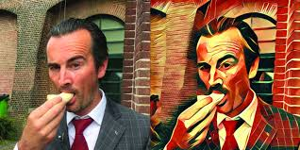


USED THIS?

Slide 15
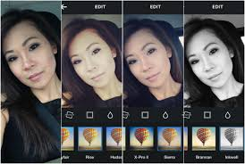
USED THIS ? (Don’t Lie :P)

Slide 16

The one that does all these cool features

Slide 17
Image processing is a method to convert an image into digital form and perform some operations on it, in order to get an enhanced image or to extract some useful information from it. It is a type of signal dispensation in which input is image, like video frame or photograph and output may be image or characteristics associated with that image.
Classical Definition

Slide 18
OpenCV is a library of programming functions mainly aimed at real-time computer vision. Originally developed by Intel, it was later supported by Willow Garage then Itseez. The library is cross-platform and free for use under the open-source BSD license
OpenCV

Slide 19
Basic functions In OpenCV
Import cv2 #importing OpenCV
cv2.imread(“directory/imagename”)
- Reads the image from specified path
cv2.imshow(“windowname”, <imagevariable>)
- Displays the image to specified window
cv2.imwrite(“directory/name”, <imagevariable>)
- Saves image to specified path

Slide 20
Basic functions in OpenCV
cv2.waitKey( )
- function waits for specifies miliseconds for any keyboard event. If “0” is passed, it waits indefinitely for a key stroke.
cv2.destroAllWindows()
- simply destroys all the windows we created
cv2.VideoCapture()
- to capture a video, you need to create a VideoCaptureobject

Slide 21
Drawing functions
img = np.zeros((512,512,3), np.uint8)
# Draw Line
img = cv2.line(img,(0,0),(511,511),(255,0,0),5)
# Draw Reactangle
img = cv2.rectangle(img,(384,0),(510,128),(0,255,0),3)
# Draw Circle
img = cv2.circle(img,(447,63), 63, (0,0,255), -1)
# Put text
cv2.putText(img,'OpenCV',(10,500), font, 4,(255,255,255),2,cv2.LINE_AA)

Slide 22

Arithmetic operations on images
# Image Addition:
output = img1 + img2
# Image Subtraction:
sub = img1 – img2
# Image Blending:
cv2.addWeighted(img1, 0.7, img2, 0.3, 0)

Slide 23
Gray Scale
Grayscale maps intensity of each pixel from black to white.
It carries only intensity information and not color information.
Thus 8-bit grayscale has values from 0-255
0 corresponds to black.
255 corresponds to white.
Grayscale is generally used when colour information is not needed and where processing should be faster because we use only one channel now rather than 3 channels.

Slide 24
Color-space Conversion
import cv2
img = cv2.imread(“spider.jpg”)
#Converting from BGR to grayscale
gray = cv2.cvtColor(img, cv2.COLOR_BGR2GRAY)
#Converting from grayscale to BGR
bgr = cv2.cvtColor(gray, cv2.COLOR_GRAY2BGR)
#Converting from BGR to HSV
hsv = cv2.cvtColor(img, cv2.COLOR_BGR2HSV)

